Slide 1
Fractions and Decimals
StAIR Project
Elizabeth Blaesser/Maccani
Click here to continue.

Slide 2
Introduction
This project is designed for Mrs. Maccani’s 3rd grade class.
The purpose of this project is to understand the relationship between whole numbers, simple fractions, and decimals. Students will demonstrate their understanding of equivalency and problem solving related to fractions and decimals.
Click here to continue.

Slide 3
Curriculum Standards
Compare fractions represented by drawings or concrete materials to show equivalency and to add and subtract simple fractions in context.
Add & subtract fractions and put fractions in simplest form.
Solve problems involving addition and subtraction of money amounts in decimal notation.
Know and understand that fractions and decimals are two different representations of the same concept.
Click here to continue.

Slide 4
What To Do:
You are to navigate through this project on your own.
Your goal is to understand fractions and decimals. You should be able to add and subtract fractions. You should be able to add and subtract with money. You should be able to apply your knowledge by answering questions and by using problems solving strategies.
The Menu/Home page (which is the next page) will allow you to navigate through this Power Point. Click on the action buttons to move through the slides. To get back to the Menu/Home Page click on the button.
Click here to continue.

Slide 5
Fractions & Decimals
Click on the lesson you would like to learn about.
Fraction Lessons
Decimal Lessons
Fraction Review
How to Subtract Fractions
Introducing Fractions to Decimals
Adding with Money
How to Add Fractions
Practice Subtracting Fractions
Using Money to Understand Decimals
Subtracting with Money
Practice Adding Fractions
Problem Solving
Practice to Understand Decimals
Real World Application
More Practice Worksheets
Cummulative
Test
More Practice Worksheets

Slide 6
Fraction Review
What Have We Already Learned?
We have learned the definition of a fraction, parts of a whole, parts of a group, compared fractions, found equivalent fractions, and how to put fractions into simplest form. Here is a review of the vocabulary:
Fraction: A symbol, such as ½, that names equal parts of a whole.
Denominator: Tells the total number of equal parts.
Numerator: Tells how many equal parts are described.
Equivalent Fractions: Fractions that name the same part of a whole.
Simplest Form: A fraction with a numerator and denominator that cannot be divided by the same divisor, except 1.
3
8
2
1
4
2
3
1
6
2

Slide 7
Test Your Knowledge!
Before we get started learning new information, take a few minutes to test your knowledge on what you have already learned about fractions.
Click on the link below:
http://www.kidsolr.com/math/fractions.html
When you get to the website, complete:
What is a Fraction?
Fraction Practice
Equivalent Fractions
Reducing Fractions

Slide 8
How to Add Fractions
Rule: When adding fractions, the denominators need to be the same. You add the numerators together, and the denominators do not change.
Example: + =
Example: + = , or (simplest form)
3
2
5
8
8
8
1
2
3
1
6
6
6
2

Slide 9
How to Add Fractions
Why do the denominators have to be the same? What does the denominator tell us?
Were you thinking that the denominators tells us the total number of equal parts? If you were, then you are on the right track! If we have a pizza that is divided into 8 equal parts and then have another pizza divided into 3 equal parts, the pieces would not be the same size! We can’t add them together if the pieces are not the same size.
Look at this: See how the pieces are not the same size?

Slide 10
How to Add Fractions
Why don’t we add the denominators together? We add the numerators together, so why not the denominators too?
Take a look at this:
If we take ¼ and add 1/8 together, would it make sense that it would become 2/12? Would the pieces become smaller? No, that is why we don’t add the denominators. The size of the pieces is not changing.
1/8
1/8
1/4
1/4
1/8
1/8
1/8
1/8
1/4
1/4
1/8
1/8

Slide 11
How to Add Fractions
1/5 | 1/5 | 1/5 | 1/5
3
1
4
+
=
5
5
5
4
2
6
+
=
1/8 | 1/8 | 1/8 | 1/8 | 1/8 | 1/8
8
8
8
6
3
Can be reduced into simplest form by dividing
the numerator and the denominator by 2.
8
4
1
2
3
1/4 | 1/4 | 1/4
+
=
4
4
4

Slide 12
Practice Adding Fractions
Check your understanding of adding fractions. Answer the following problems on the pages that follow.
Things to remember:
Add the numerators
Make sure the denominators are the same
Don’t add the denominators together
Make sure your answer is in simplest form

Slide 13
1/6 | 1/6 | 1/6 | 1/6 | 1/6
3
2
+
=
6
6
a.
6
6
b.
5
12
c.
5
6

Slide 14
You’re Right! Great Job!
Next Question

Slide 15
Try Again!
You Can Do It!
Did you add correctly?
Did you remember NOT to add the denominators?
Back
to Question

Slide 16
2
4
+
=
12
12
a.
1
2
b.
6
24
c.
6
12

Slide 17
You’re Right! Great Job!
Next
Question

Slide 18
Try Again!
You Can Do It!
Did you put your answer in simplest form?
Did you remember to NOT add the denominators?
Back
to
Question

Slide 19
1
1
+
=
3
3
a.
2
3
b.
3
3
c.
2
6

Slide 20
You’re Right! Great Job!
Next
Question

Slide 21
Try Again!
You Can Do It!
Did you add correctly?
Did you remember to NOT add the denominators?
Back
to
Question

Slide 22
3
5
+
=
10
10
a.
8
10
b.
4
5
c.
8
20

Slide 23
You’re Right! Great Job!
Next
Lesson

Slide 24
Try Again!
You Can Do It!
Did you put your answer in simplest form?
Did you remember to NOT add the denominators?
Back
To
Question

Slide 25
How to Subtract Fractions
Rule: When subtracting fractions, the denominators need to be the same. You subtract the numerators but the denominators do not change. Just as you did in adding fractions, the size of the pieces is not changing, you are just taking away a certain amount of pieces.
Example:
Think of subtracting whole numbers, such as, 5 – 1 = 4. You subtract the same way with the numerators in the fractions.
5
-
1
4
=
8
8
8

Slide 26
How to Subtract Fractions
The same rules apply with subtracting as they do with adding.
Denominators need to be the same
Subtract the numerators
You do NOT subtract the denominators because the size of the pieces does not change.
2
3
-
1
Does NOT equal
0
6
6
We can’t start with three sixths and end up with zero.
We are taking away 1 piece out of 3, so we would have two sixths left over.

Slide 27
How to Subtract Fractions
Below is an example of how to subtract fractions. The red represents the fraction
we are starting with and the X represents the number of pieces that are being
subtracted.
5
1/8 | 1/8 | 1/8 | 1/8 | 1/8
8
5
-
2
=
8
8
x
x
1/8 | 1/8 | 1/8 | 1/8 | 1/8
3
How many eighths do we have left? 3! So the answer is
8

Slide 28
How to Subtract Fractions
4
-
3
=
1
x
x
x
7
7
7
1/7 | 1/7 | 1/7 | 1/7
5
-
3
2
=
1
, or in simplest form
6
6
6
3
x
x
x
2
=
1
1/6 | 1/6 | 1/6 | 1/6 | 1/6
6
3
1/3

Slide 29
How to Subtract Fractions
What if you were given the following problem?
How could you solve this problem? Look at this picture.
1 stands for one whole. Since you are subtracting fourths, you can change 1 into
1
-
3
4
1
1/4
1/4
1/4
1/4
4
4

Slide 30
Practice Subtracting Fractions
Check your understanding of subtracting fractions. Answer the following problems.
Things to remember:
Subtract the numerators
Make sure the denominators are the same
Don’t subtract the denominators
Make sure your answer is in simplest form

Slide 31
6
4
-
=
9
9
x
x
x
x
1/9 | 1/9 | 1/9 | 1/9 | 1/9 | 1/9
a.
2
18
b.
2
9
c.
2
0

Slide 32
You’re Right! Great Job!
Next
Question

Slide 33
Try Again!
You Can Do It!
REMEMBER:
Do NOT add the denominators
Do NOT subtract the denominators
Back
to
Question

Slide 34
7
3
-
=
8
8
x
x
x
1/8 | 1/8 | 1/8 | 1/8 | 1/8 | 1/8 | 1/8
a.
1
2
b.
3
8
c.
4
8

Slide 35
You’re Right! Great Job!
Next
Question

Slide 36
Try Again!
You Can Do It!
REMEMBER:
Did you subtract correctly?
Did you put your answer in simplest form?
Back
to
Question

Slide 37
11
7
-
=
12
12
a.
2
6
b.
1
3
c.
4
12

Slide 38
You’re Right! Great Job!
Next
Question

Slide 39
Try Again!
You Can Do It!
REMEMBER:
Did you put your answer in simplest form?
Back
to
Question

Slide 40
6
1
-
8
a.
2
8
b.
5
8
c.
1
4

Slide 41
You’re Right! Great Job!
Next
Lesson

Slide 42
Try Again!
You Can Do It!
REMEMBER:
Did you subtract correctly?
Did you put your answer in simplest form?
Back
to
Question

Slide 43
Problem Solving
Solving Word Problems: UPS and Check
Understand: What is the problem asking you to solve?
Plan: Decide HOW you are going to solve the problem.
Solve: Complete the operations to get your answer
Check: Does my answer make sense?

Slide 44
When solving problems related to fractions, one strategy you can use is: Draw a Picture and Write a Number Sentence
Example: Mrs. Maccani had ¾ of a whole turkey sandwich. She gave 2/4 of the turkey sandwich to Julie. She gave the rest of the sandwich to Alex. What fraction of the sandwich did she give to Alex?
1st: Understand: What are they asking me to solve? I have underlined the question. I know my answer will be a fraction and I want to find out how much Mrs. Maccani gave to ALEX not Julie.
2nd: Plan: I will use the Draw a Picture & Write a Number Sentence strategy
¼-Julie | ¼-Julie | 1/4
3
-
2
=
4
4

Slide 45
3rd: Solve:
3
-
2
=
1
4
4
4
4th: Check: Does it make sense?
I started with
3
and I had to take away
2
4
4
So I should end up with less. I think my answer makes sense.
I also checked it with my picture.
¼-Julie | ¼-Julie | 1/4
I took the time to go through the problem solving steps to get the correct answer. Can you do the same?

Slide 46
Sam had a piece of ribbon that was 7/8 yard long. She cut off 2/8 yard to make a bow. She used the rest of the ribbon to make a tail for her kite. How much ribbon did she use to make the kite?
1/8- bow | 1/8-bow | 1/8-kite | 1/8-kite | 1/8-kite | 1/8 kite | 1/8 kite
7
-
2
=
8
8
Understand: Do you know what they are asking you to solve?
Plan: Use the picture and number sentence to help you
Solve: Answer the problem
Check: Does it make sense?
Click on your answer.
5
4
5
8
8

Slide 47
You’re Right! Great Job!
Next
Question

Slide 48
Try Again!
You Can Do It!
Back
to
Question

Slide 49
Bill colored 3/5 of a flag red. Then he colored 1/5 of the same flag yellow. What fraction of the flag did he color in all?
Understand: Do you know what they are asking you to solve?
Plan: Draw a picture and write a number sentence to help you.
Solve: Answer the problem.
Check: Does it make sense?
Click on your answer.
2
4
4
5
5

Slide 50
You’re Right! Great Job!
More
Practice

Slide 51
Try Again!
You Can Do It!
Back
to
Question

Slide 52
More Practice
Click on the links below to download worksheets for extra practice.
Adding Fractions
Subtracting Fractions
Problem Solving
Click on the link below to play Math Splat! Have Fun!
Adding & Subtracting Fractions!! Have Fun!

Slide 53
Introducing Fractions to Decimals
Vocabulary:
Tenths: ten equal parts of a whole or a set.
Hundredths: one hundred equal parts of a whole or set.
Decimal point: a dot used to separate ones from the tenths in a number.
Decimal: a number with one more more digits to the right of the decimal point.

Slide 54
Tenths Place
Tenths: ten equal parts of whole or set.
In the picture to the left, there are 3 red parts
out of 10.
As a fraction, we would write:
As a decimal, we would write: 0.3
3
10
Think about place value in this number:
4 5 . 3
T
E
N
S
O
N
E
S
T
E
N
T
H
S

Slide 55
Hundredths Place
Hundredths: one hundred equal parts
of a whole or set. In the picture to the left,
there are 5 red parts out of 100.
As a fraction, we would write:
As a decimal, we would write: 0.05
5
100
Think about place value in this number:
4 5 . 0 5
T
E
N
S
O
N
E
S
T
E
N
T
H
S
H
U
N
D
R
E
D
T
H
S

Slide 56
How can you write a decimal and fraction for the same part of a whole?
Fractions and decimals are two ways to show parts of a whole.
Look at the smiley faces. How many smiley faces are there in all? 10 Since there are 10 equal parts to the set, we will be working with tenths.
What part of the set of smiley faces is green?
Fraction: Decimals: 0.5
What part of the set of smiley faces is pink?
Fraction: Decimal: 0.3
5
10
3
10

Slide 57
Writing Fraction and Decimals
Examples of writing fractions and decimals for each red part.
16
Fraction:
Decimal: 0.16
100
7
Fraction:
Decimal: 0.7
10
Ready to Try It?
Click Here!

Slide 58
Choose the correct fraction & decimal for the red shaded part in the
picture below. Remember to think about your place value.
6
4
4
0.6
0.4
0.04
10
10
100

Slide 59
You’re Right! Great Job!
Next
Question

Slide 60
Try Again!
You Can Do It!
Back
to
Question

Slide 61
Choose the correct fraction & decimal for the red shaded part in the
picture below. Remember to think about your place value.
48
0.48
100
52
0.052
100
52
0.52
100

Slide 62
You’re Right! Great Job!
Next
Lesson

Slide 63
Try Again!
You Can Do It!
Back to
Question

Slide 64
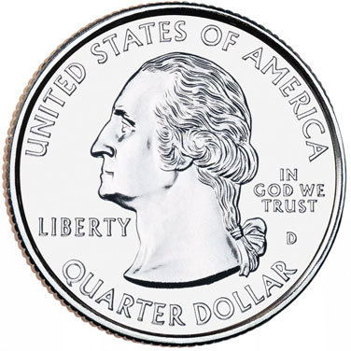
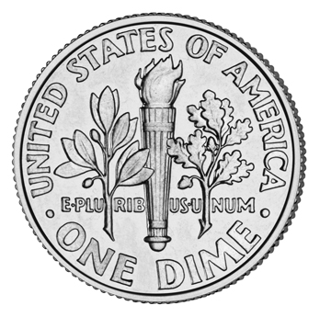
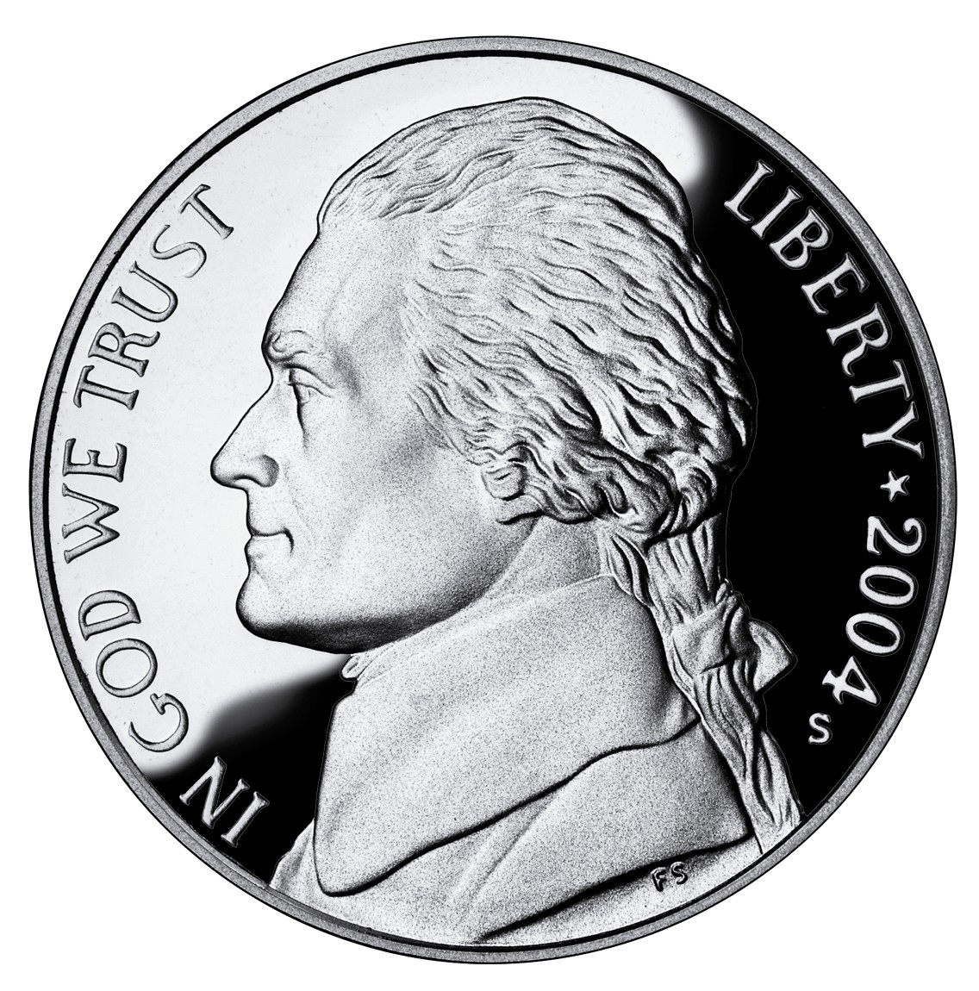
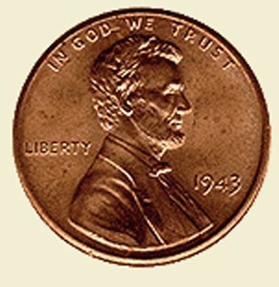
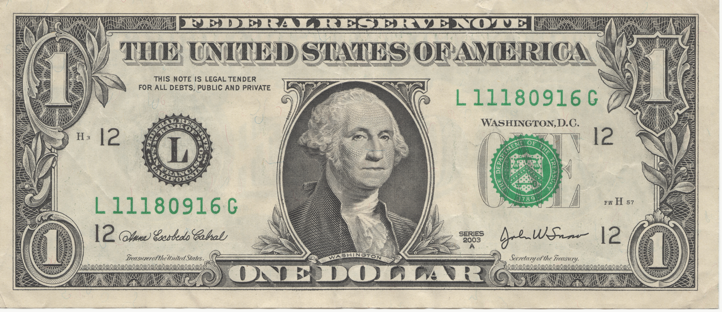
Using Money to Understand Decimals
How are fractions and decimals related to money?
Money can help you understand place value in decimals through hundredths.
First let’s review money:
Dime = $0.10
Nickel = $0.05
Penny = $0.01
Quarter = $0.25
1 Dollar = $1.00

Slide 65
Think About Place Value
Penny =
100 pennies are equal to a dollar
A penny is one hundredth of a dollar
Each penny has a value of $0.01
Dime =
10 dimes are equal to a dollar
A dime is one tenth of a dollar
Each dime has a value of $0.10
1
1 Dollar =
$1.00
100 hundred pennies
10 dimes
1
100
10
Look at the place value for the amount $2.58:
$ 2 . 5 8
Dollar Sign
Pennies
Hundredths
Dollars
Ones
Decimal
Point
Dimes
Tenths

Slide 66
Different Ways to Write $2.58
Standard Form: $2.58
Word Form: Two dollars and fifty eight cents. (The decimal point is read by saying “AND.” Two dollars AND fifty eight cents.
Expanded Form: 2 dollars + 5 dimes + 8 pennies
2 ones + 5 tenths + 8 hundredths
Dollars = Ones
Dimes = Tenths
Pennies = Hundredths

Slide 67
Quarters =
Four quarters make a dollar
Each quarter Is of a dollar
1
4
1
25
=
=
$0.25
4
100
How about 2 quarters? How much is 2 quarters worth?
2 quarters = $0.50 = =
50
1
100
2
Can you figure out how much 3 quarters is worth in
fractions of a dollar?
Can you write it as a decimal too?
Find out on the next page!

Slide 68
How much is 3 quarters worth?
Choose the decimal that represents three quarters:
$0.075
$0.03
$0.75
Choose the fraction that represents three quarters:
70
3
1
100
4
3

Slide 69
You’re Right! Great Job!
Back to
Question
More
Practice

Slide 70
Try Again!
You Can Do It!
Back
to
Question

Slide 71
Practice to Understand Decimals
REMEMBER: Think about place value!
Dollars = Ones Dimes = Tenths Pennies = Hundredths
Click on the link below to download the worksheet.
The worksheet will give you practice at understanding decimals and
How decimals are related to fractions and money
Using Money to Understand Decimals Worksheet
Next
Lesson

Slide 72
Adding with Money
Think about what you already know about adding whole numbers. You have to line up place value, right? The same rules apply when adding money.
1st: Line up the decimal points! When you line up the decimal points, all the other numbers will be in the correct place!
2nd: Add as you would with whole numbers.
3rd: Write the answer (sum) with dollar and cents. Write the dollar sign( $) and decimal point.
CHECK OUT my example on the next page!

Slide 73
Adding with Money
Step 1
Step 2
Step 3
Write $ and .
Line Up the Decimals!
ADD
$ 5 . 4 7
+ 6 . 8 9
1
1
$ 5 . 4 7
+ 6 . 8 9
12 3 6
$ 5 . 4 7
+ 6 . 8 9
$12. 3 6

Slide 74
Practice Addition Problems
Click on you answer:
Click on your answer:
$ 9 . 0 9
+ 2 . 8 3
$1 3 . 0 6
+ 9 . 5 6
$12.92
$11.92
$22.612
$22.72
$11.93
$22.62

Slide 75
You’re Right! Great Job!
Back
to
Question
Next
Lesson

Slide 76
Try Again!
You Can Do It!
Back
to
Question

Slide 77
Subtracting with Money
Think about what you already know about subtracting whole numbers. You have to line up place value, right? You have to place the greater amount at the top, right? The same rules apply when subtracting money.
1st: Line up the decimal points! When you line up the decimal points, all the other numbers will be in the correct place!
2nd: Subtract as you would with whole numbers.
3rd: Write the answer (difference) with dollar and cents. Write the dollar sign and decimal point.
CHECK OUT my example on the next page!

Slide 78
Subtracting with Money
Step 2
Step 1
Step 3
SUBTRACT
Write $ and .
Line Up the Decimals!
9
9
$10 . 0 7
- 1 . 6 8
10
10
17
0
$10 . 0 7
- 1 . 6 8
$ 8 . 3 9
$1 0 . 0 7
- 1 . 6 8
8 3 9

Slide 79
Practice Subtraction Problems
Click on you answer:
Click on you answer:
$ 2 0 . 0 0
- 6 . 8 1
$ 4 . 0 0
- 2 . 6 4
$18.81
$13.19
$1.36
$2.64
$14.89
$2.46

Slide 80
You’re Right! Great Job!
Back
to
Question
Next
Lesson

Slide 81
Try Again!
You Can Do It!
Back
to
Question

Slide 82
More Practice Worksheets
Click on the links below to download extra practice worksheets.
Fractions and Decimals
Adding and Subtracting Money
Money Challenge
Problem Solving

Slide 83
Real World Application
Why do we need to know about fractions and decimals? When do we use fractions, decimals, and money in our real lives?
Click on this link to watch a video of an example of a real world application. Decimals- Money for Groceries
HERE IS YOUR CHALLENGE:
Ask family and friends: “When do you use fractions, decimals, or money in your daily life?” If they give you an answer that you have already received, ask them for another example. NO REPEATS. Make a list of 20 ways we use fractions, decimals, and money every day.

Slide 84
Cummulative Test
WOW! You completed this learning project!
I am so proud of you!
Now it’s your time to SHINE! Show me how much you have
learned by completing the following tests. Turn the tests into
me at school when you are finished.
Fraction Test
Decimal Test

